Slide 1

BikeDekho Data Analysis
-Business Analyst/Data Analyst
-Aditya Verma

Slide 2

Agenda of the Meeting
Welcome & Introductions – Overview of meeting objectives.
Project Overview – Scope of the bike sales analysis and business problem.
Data Preparation – Cleaning, organizing data, and reviewing key fields.
Exploratory Data Analysis (EDA) – Analysis using Excel formulas and PivotTables with initial observations.
Key Insights & Findings – Customer demographics, bike purchase behavior, commute patterns, and sales trends.
Dashboard Walkthrough – Interactive features and how visuals support decision-making.
Project Objectives Recap – Data cleaning, EDA, pattern discovery, and dashboard creation.
Conclusion & Business Takeaways – Summary of insights and impact Q&A and Next Steps.

Slide 3
Introduction
Founded to simplify bike buying decisions, Bike Dekho serves as a data-driven platform for customers evaluating bike options.
The platform aggregates and analyzes bike sales data from over 1,000 customers, covering key factors such as age, income, education, purchase behavior, and commute patterns.
~64% of customers fall into the core 30–50 age group, which also shows the highest bike purchase rate (~52%).
Income analysis shows that nearly 90% of the customer base earns below ₹1,00,000, supporting targeted marketing and pricing strategy decisions.
Education profiling indicates that ~57% of customers have at least a Bachelor’s or Partial College qualification, helping tailor communication and product positioning.
Commute behavior reveals that 53%+ customers live within 2 miles, highlighting opportunities for localized promotions, test ride campaigns, and dealership placement optimization.
The analysis supports data-backed decision making through interactive dashboards and insights, enabling stakeholders to focus on high-value segments.

Slide 4
Data Checking & Cleaning
Initial dataset contained 1,026 records.
Identified and removed 26 duplicate entries, resulting in 1,000 distinct records for analysis.
Performed deduplication to ensure each customer record is unique.
Conducted data consistency checks to identify case-sensitive variations in categorical fields (e.g., Yes vs yes).
Applied standardization to ensure uniform text values across columns.
Validated categorical fields to eliminate inconsistent string values.
Final dataset was reviewed for completeness, accuracy, and consistency, ensuring readiness for analysis and dashboarding.

Slide 5
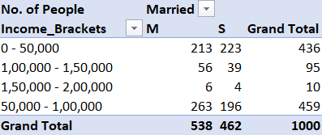
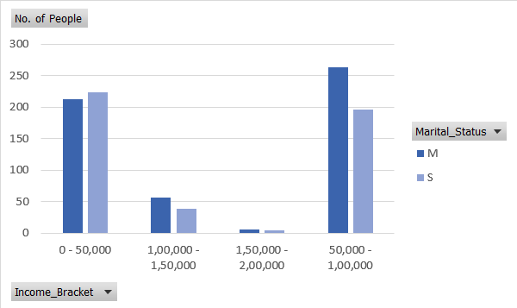
Insights: Income Distribution by Marital Status
Income is heavily concentrated below ₹1,00,000, with ~900 people below and only ~107 above.
👉 About 89% fall under the ₹1,00,000 bracket.
Married slightly outnumber Singles overall (Married ~543, Singles ~464).
👉 A difference of ~79 people favors Married individuals.
Singles lead only in the ₹0–50k bracket (Singles ~225 vs Married ~215).
👉 A small ~2% gap.
Married dominate middle and higher income ranges. They lead by ~70 in ₹50k–₹1L, ~15 in ₹1L–₹1.5L, and form ~67% in ₹1.5L–₹2L (small sample).
👉 Higher incomes consistently skew toward Married individuals.
A sharp drop occurs after ₹1,00,000, falling from ~460 (₹50k–₹1L) to ~95 (₹1L–₹1.5L).
👉 Roughly a 79% decline beyond ₹1,00,000.
Conclusion:
This chart shows that income distribution is heavily concentrated below ₹1,00,000, with nearly 90% of individuals falling in the lower income brackets. Singles slightly dominate only at the lowest income level, while married individuals consistently outnumber singles as income increases. There is also a sharp drop in population beyond ₹1,00,000, indicating limited representation in higher income ranges. Overall, the pattern suggests that marital status becomes more associated with higher income levels, but the dataset is primarily driven by lower-income groups.

Slide 6
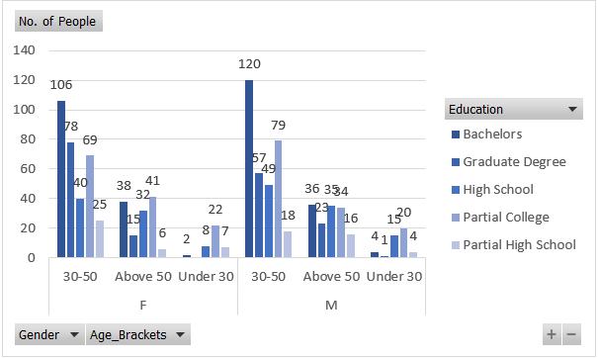
Customer Demographics: Education, Age & Gender
Gender distribution is almost balanced Female: 489 (48.9%) Male: 511 (51.1%)
👉 Slight male dominance of just 22 people.
Age group 30–50 is the dominant segment for both genders Total age 30–50: 641 people (64.1%) Breakdown: Female 30–50: 318 Male 30–50: 323
👉 Nearly identical participation, making this the core demographic.
Above 50 is a secondary segment Total Above 50: 276 (27.6%) Female: 132 Male: 144
👉 Males slightly higher by 12 people.
Under 30 is extremely small Total Under 30: 83 (8.3%) Female: 39 Male: 44
👉 Young population is underrepresented in this dataset.
Bachelor’s is the most common education level Out of 1000 total: Bachelor’s: 306 (30.6%) Partial College: 265 (26.5%) High School: 179 (17.9%) Graduate Degree: 174 (17.4%) Partial High School: 76 (7.6%)
👉 Nearly 57% fall into Bachelor’s + Partial College.

Slide 7
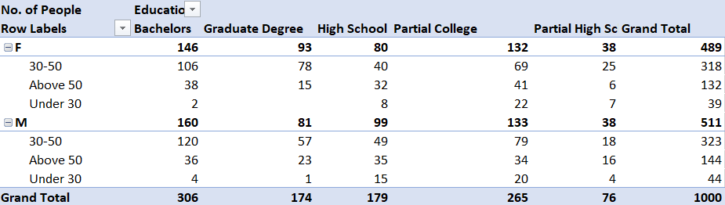
Education concentration peaks in age 30–50 Examples: Bachelor’s (30–50): 226 out of 306 (~74%) Graduate Degree (30–50): 135 out of 174 (~78%) Partial College (30–50): 148 out of 265 (~56%)
👉 Most higher-education individuals belong to the 30–50 age group.
Male–Female education patterns are similar Both genders show highest counts in: Bachelor’s Partial College No education category shows extreme gender imbalance.
👉 Education distribution is consistent across genders.
Conclusion
This visualization shows a nearly balanced gender distribution, with males slightly higher at 51%. The dataset is strongly dominated by the 30–50 age group, contributing over 64% of the population, making it the core demographic across all education levels. Bachelor’s and Partial College are the most common education categories, together accounting for more than half of the total population. Higher education levels are heavily concentrated in the 30–50 segment, while under-30 representation is minimal. Overall, the data indicates that middle-aged individuals with moderate to higher education form the primary population, with education patterns remaining consistent across genders.

Slide 8
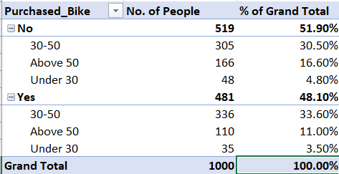
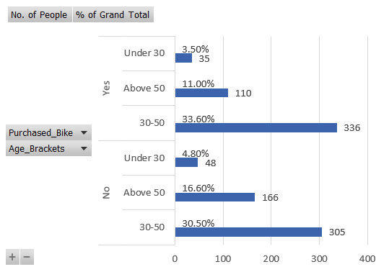
Impact of Age on Bike Purchasing Behavior
Nearly even split between buyers and non-buyers No: 519 (51.9%) Yes: 481 (48.1%)
👉 Slightly more non-buyers by 38 people.
Age 30–50 dominates both purchases and non-purchases Out of 1000 total: 30–50: Buyers: 336 (33.6%) Non-buyers: 305 (30.5%) Total: 641 (64.1%)
👉 Almost 2 out of 3 people fall in this age group.
Best conversion comes from the 30–50 segment Purchase rate within each age group: 30–50: 336 / 641 ≈ 52.4% Above 50: 110 / 276 ≈ 39.9% Under 30: 35 / 83 ≈ 42.2%
👉 30–50 shows the highest likelihood to purchase.
Above 50 has the weakest purchase behaviour Non-buyers: 166 (16.6%) Buyers: 110 (11.0%)
👉 Gap of 56 people, indicating lower engagement.
Under 30 is a very small segment Total under 30: 83 (8.3%) Buyers: 35 (3.5%)
👉 Limited impact on overall sales due to low volume.
Conclusion
Bike buyers and non-buyers are nearly balanced, with buyers at 48%. The 30–50 age group dominates the dataset and shows the highest purchase rate (~52%), making it the strongest segment. Customers above 50 convert least, while under-30 participation is minimal. Overall, middle-aged customers drive most purchases, highlighting age as a key factor in buying behavior.

Slide 9
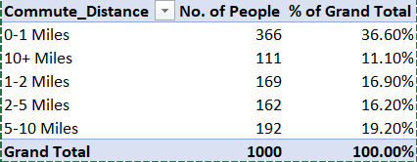
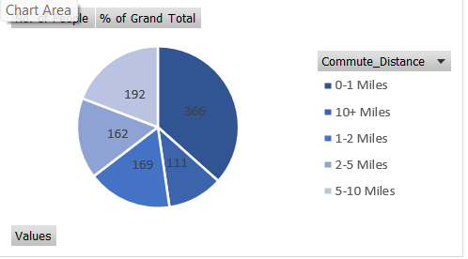
Customer Distribution by Commute Distance
Short commutes dominate the dataset. About 366 people (36.6%) travel 0–1 miles, making it the largest group.
👉 Together, 0–2 miles = 535 people (53.5%). More than half live within 2 miles.
Mid-range commutes form a significant share. Around 169 people (16.9%) commute 1–2 miles and 162 (16.2%) travel 2–5 miles, together accounting for over one-third of the population.
5–10 mile commutes remain common. Approximately 192 people (19.2%) fall into this bracket, representing nearly one-fifth of all respondents.
👉 Combined 2–10 miles = 354 people (35.4%)
Longer commutes (10+ miles) are least common. Only 111 people (11.1%) travel more than 10 miles.
👉 Overall, nearly 70% commute within 5 miles, highlighting a strong preference for short-distance travel.
Conclusion
This visualization shows that commute distances are heavily skewed toward shorter ranges, with over 53% of individuals living within 2 miles and nearly 37% within just 1 mile. Mid-range commuters between 2 and 10 miles account for about 35% of the population, while long-distance commuters above 10 miles form a relatively small segment at 11%. Overall, the data indicates a predominantly short-commute population, suggesting proximity plays a significant role in this customer base.

Slide 10
Key Insights
Income Concentration: Nearly 90% of customers earn below ₹1,00,000, with Married individuals increasingly represented at higher income levels, while Singles dominate only the lowest bracket.
Primary Buyer Segment: The 30–50 age group drives bike purchases, contributing 64% of the population and showing the highest purchase rate (~52%), making it the strongest customer segment.
Balanced Demographics: Gender split is nearly even (51% Male, 49% Female). Education is concentrated in Bachelor’s and Partial College (~57%), with higher education largely clustered in the 30–50 age group.
Commute Behavior: Over 53% of customers live within 2 miles, and only 11% commute more than 10 miles, indicating a predominantly short-distance customer base.

Slide 11
Conclusion
Nearly 90% of customers fall below ₹1,00,000 income, with married individuals becoming more common as income increases.
The 30–50 age group is the strongest segment, contributing the largest population share and the highest bike purchase rate (~52%).
Bike buyers and non-buyers are almost balanced, but middle-aged customers drive most purchases.
Gender distribution is nearly equal, indicating minimal impact of gender on buying behavior.
Education is concentrated in Bachelor’s and Partial College, reflecting a moderately educated customer base.
Over 53% of customers live within 2 miles, showing a strong skew toward short commute distances.
Higher-income and higher-education groups are mainly clustered in the 30–50 age range.
Overall Takeaway
Middle-aged, moderately educated customers with shorter commute distances form the core customer base.
Age and income are the strongest drivers of bike purchasing behavior, while gender plays a limited role.

Slide 12
Thank You
-Business Analyst/Data Analyst
-Aditya Verma

